Slide 1
Journalism Genres
Ash Jayy, Ellie, Leigh, Liz, Toby & Liam

Slide 2
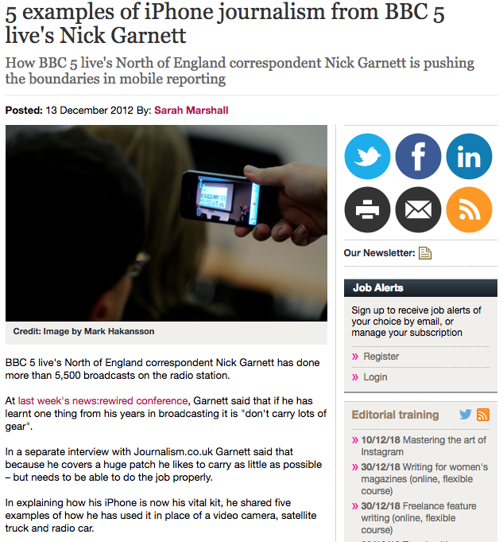
Mobile Journalism
https://www.journalism.co.uk/news/five-examples-of-iphone-journalism-from-bbc-5-live-s-nick-garnett/s2/a551533/
In this article, a journalist that works for BBC radio 5 live gives five different examples of how he creates Journalistic content on the go.

Slide 3

Human Interest
An example of human interest journalism is when Nick Grimshaw covers celebrity gossip on his radio show. Yesterday he spoke about Ariana Grande’s new song and the timing of it. This covers a slight shock as the song was a release drop. Grimshaw also teased at the failed relationship of Grande and her ex-fiancé Pete Davidson.

Slide 4
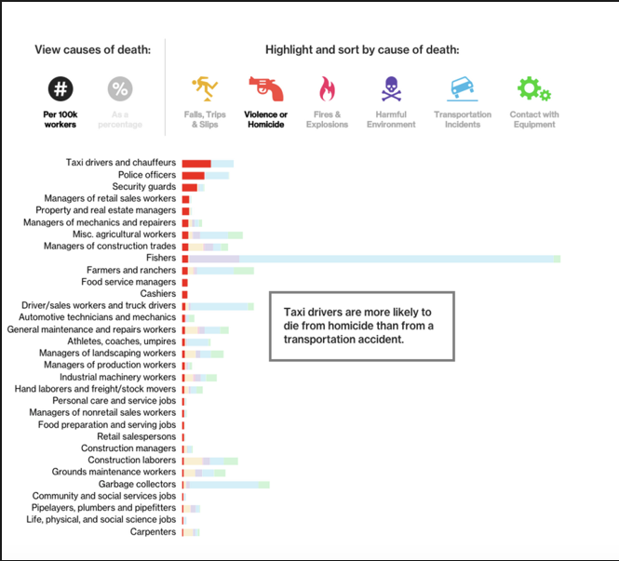
Data Journalism
Data journalism is exactly what it sounds like, journalists using data to enhance their stories. If you’ve ever seen a graph or an infographic in a news story, then you’ve been exposed to data journalism. Data is a great source for journalists to use because it lends credibility to their sources and can help explain complex topics to the public in a visual way.

Slide 5
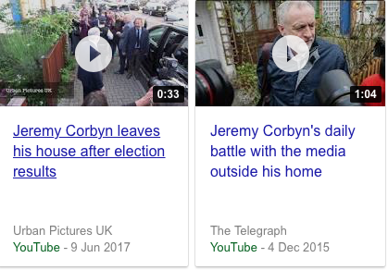
Ambush Journalism
https://www.youtube.com/watch?v=vEeGKqqQT5k
The term “ambush interview” refers to an unscheduled interview that occurs because someone has forced or tricked another into on-the-spot participation. Although the press typically uses the term to describe a journalism interview tactic,
Definition of an Ambush interview is, an unfair, deceptive or manipulative journalism practise of select use of interviews so as to create deceitful impressions.

Slide 6
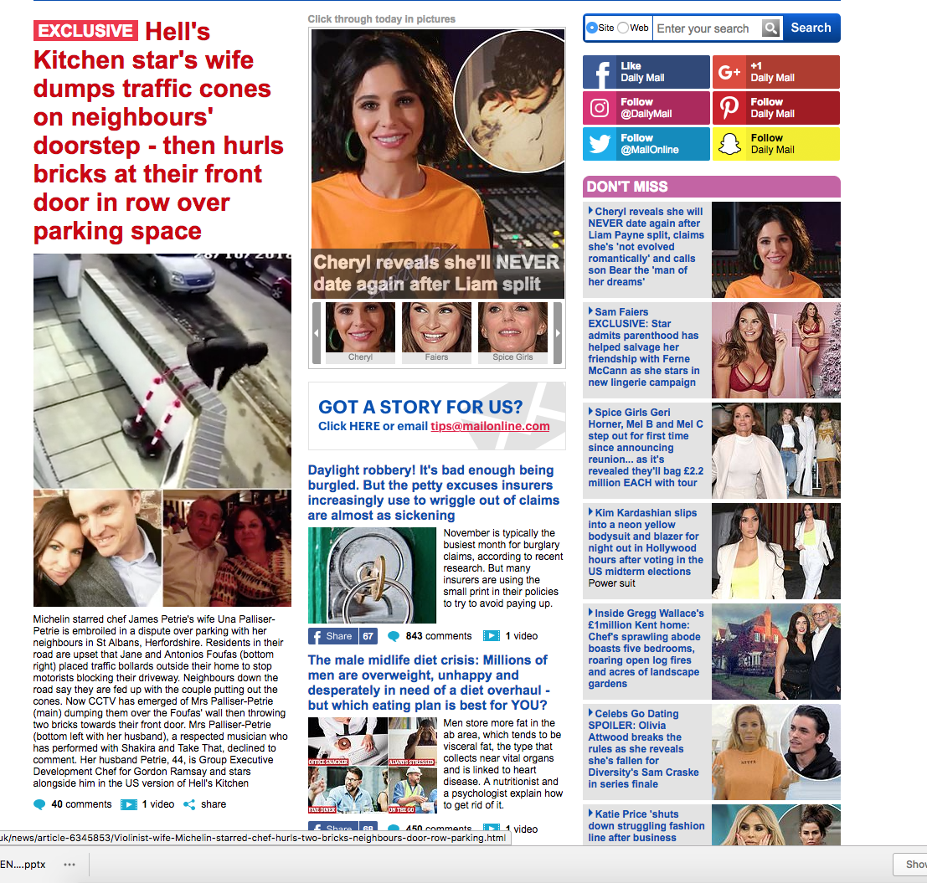
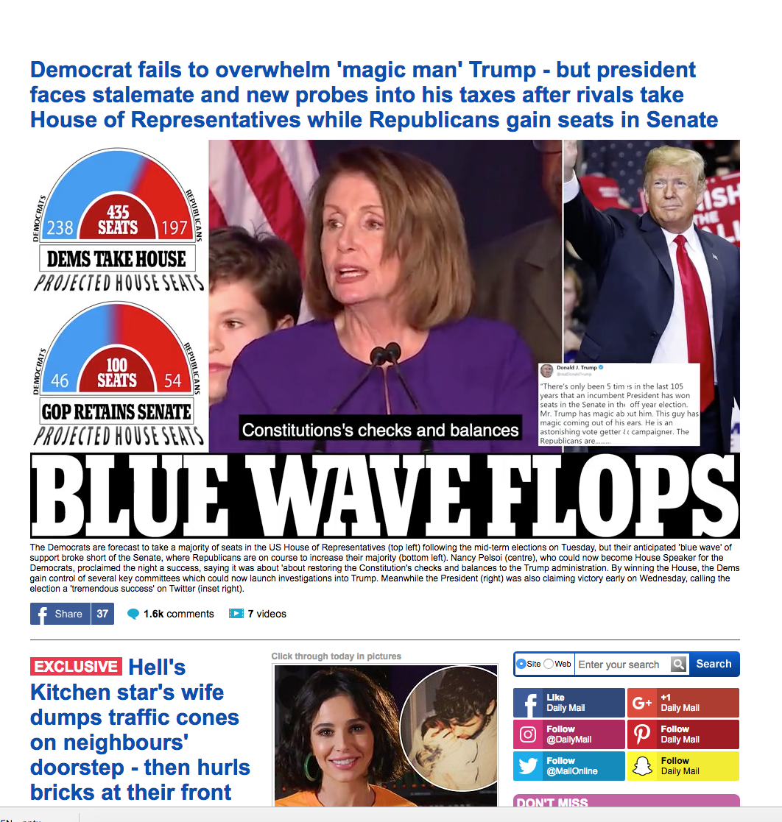

Sensational Journalism

Slide 7
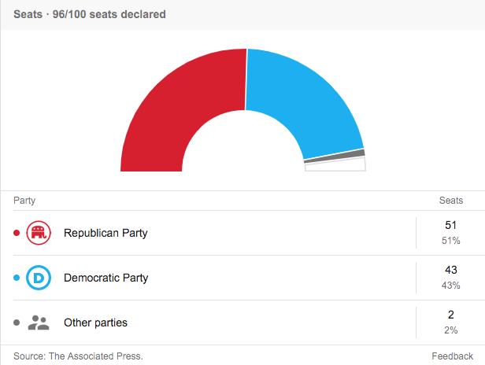
Data Journalism

Slide 8
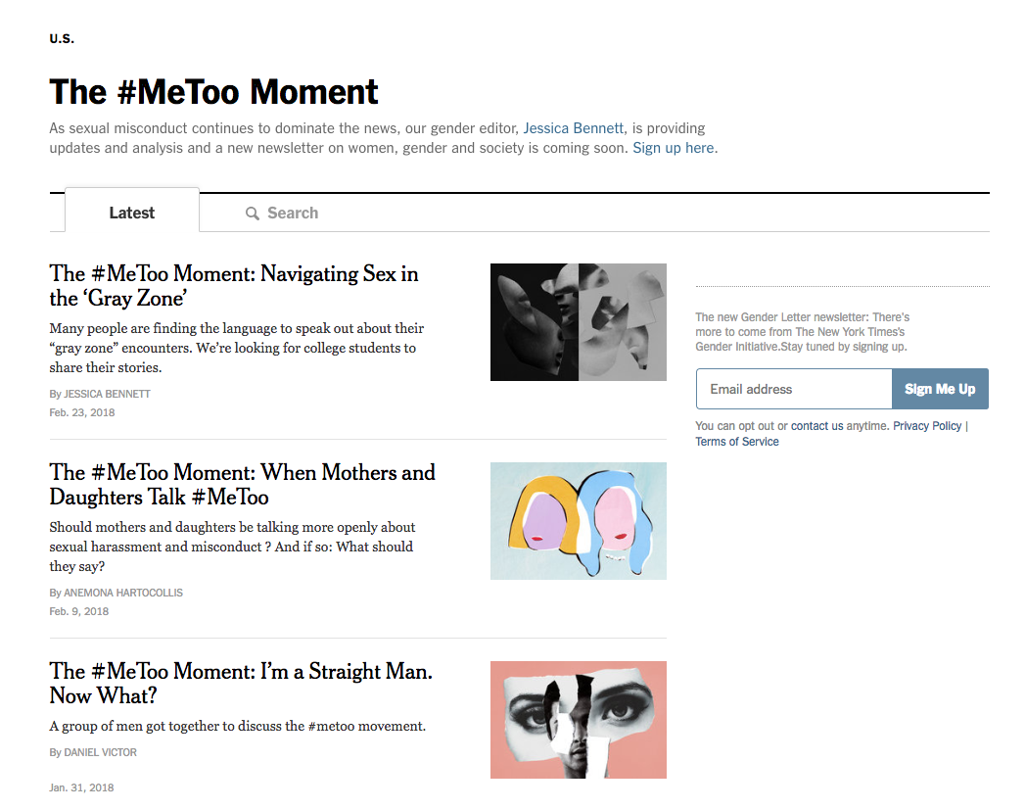
Citizen Journalism

